Slide 1

SWAHILI TRANSCRIPTION TOOL.
Group Member
MPONJOLI JOSEPH
RIGOBERT KIATA
JULIETH SHAYO
CLEOPHACE KAJETANI
SULEMANI BAKARI
Supervisor Name.
Mr. Augustino Mwogosi

Slide 2
Problem Statement
Swahili transcription has been implemented by multiple transcription platforms around the world except TANZANIA, which is the home land for Kiswahili as a Language.
Under Resourced Language being a factor for low-levels of accuracy in transcribing Swahili Speech into the Swahili text. This is a problem that has led to under development of the Swahili Transcription tool.

Slide 3
Project Objectives.
Main Objective.
Developing a Swahili transcription tool using machine learning.
Specific Objectives.
To collect and prepare a Swahili words dataset for transcription.
To create a Swahili transcription model using natural language processing algorithm.
To Implement the model using web-based system.

Slide 4
Work done so Far
OBJECTIVES | WHAT WE HAVE DONE | DELIVERABLES | ACCOMPLETION
To collect and prepare a Swahili words dataset for transcription. | Step 1: Collecting Data - Using open source data sets. Step 2: Pre-processing of Data sets through Cleaning and Transforming data into same formats. Step 3: Data Splitting: -We Split the collected and cleaned data into training, validation, and test sets | Refer to the next slides showing data before cleaning, after cleaning and Cleaning process used. | 95%
To create a Swahili transcription model using natural language processing algorithm. | Step 4: Selecting The best Model for Training. | We have Selected model for training, as Batch streaming model as our training model. | 10%
To Implement the model using web-based system. | Step 5: Deploying the Model to a Web based Application. | We are expecting to start Web development using python framework called flask | 0%

Slide 5
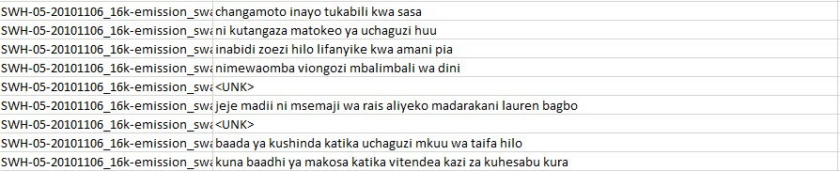
Work done so Far
BEFORE DATA CLEANING
The above data consists of data which are not well organized including Unknown data that needs modification for latter training of our model

Slide 6
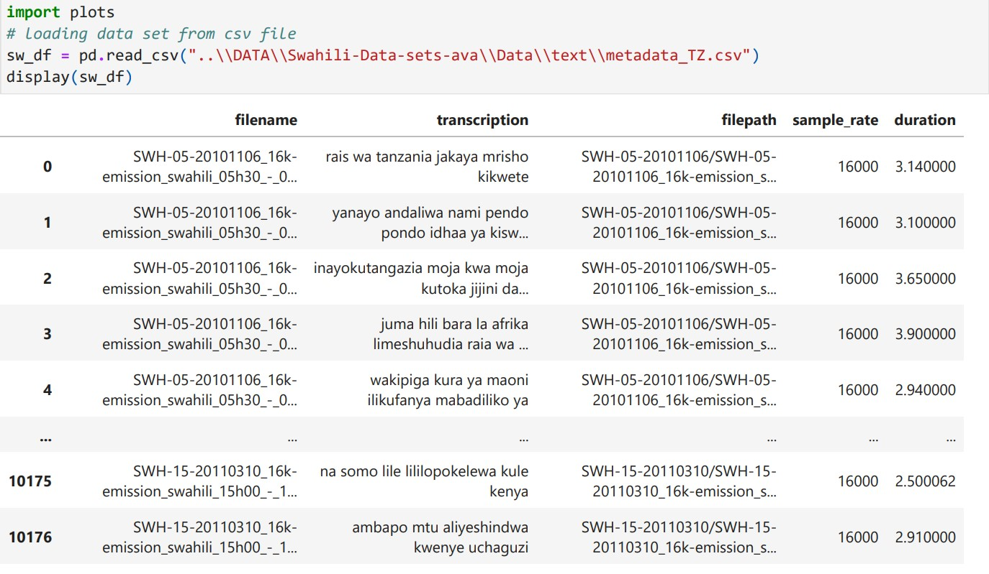
PROCESS OF DATA CLEANING
Work done so Far
Loading Data:

Slide 7
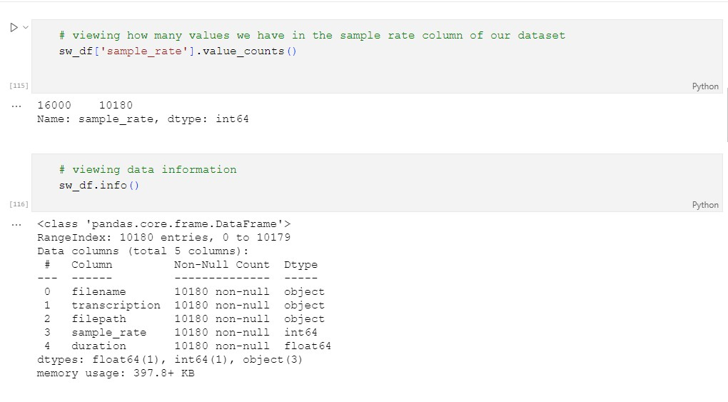
PROCESS OF DATA CLEANING
Work done so Far
Checking Data Information:

Slide 8
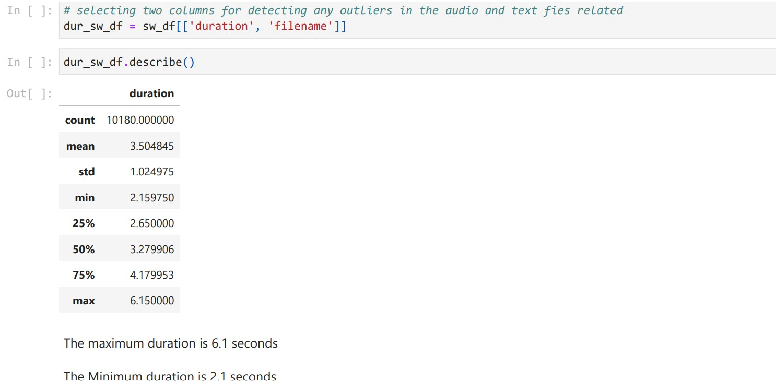
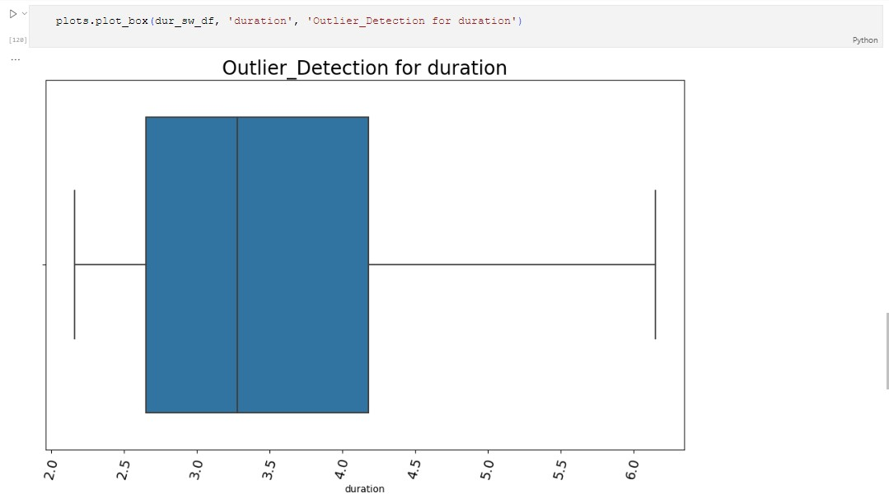
PROCESS OF DATA CLEANING
Work done so Far
Checking For min & max duration
Checking for Outliers in the duration.
No outliers detected.

Slide 9
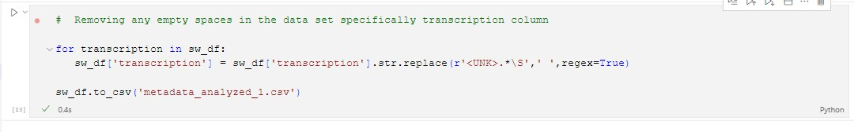
PROCESS OF DATA CLEANING
Work done so Far
Removing <UNK> value inside the data set and extra within sentences empty spaces

Slide 10
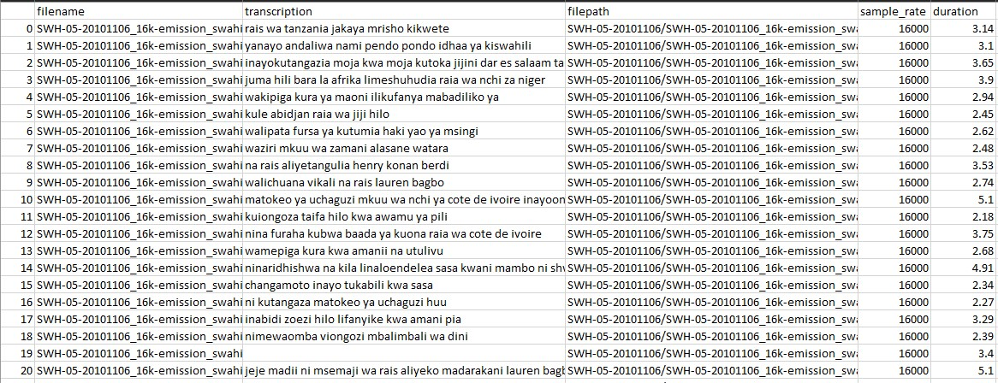
Work done so Far
AFTER DATA CLEANING

Slide 11
FUTURE WORK
We are expecting to Train model after cleaning of data and transforming them into specific format then splitting them for Easy and accuracy model operation.
We are expecting also to deploy our model into web based application using flask framework.
We are expecting to test and receive feedback for more modification of our model and Accuracy performance of our model

